Slide 1


Lecture 4
Organic Chemistry: Fundamentals and Applications (CSO201A)
Dr. Srinivas Dharavath
Assistant Professor
Department of Chemistry
Indian Institute of Technology, Kanpur
Kanpur- 208016
E-mail: srinivasd@iitk.ac.in

Slide 2
IUPAC nomenclature of organic compounds
International Union of Pure and Applied Chemistry (IUPAC)

Slide 3
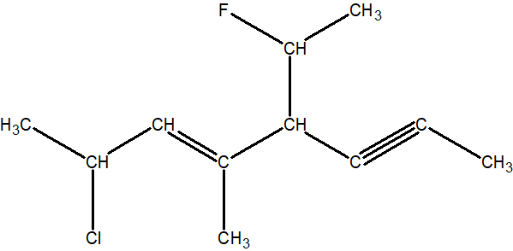
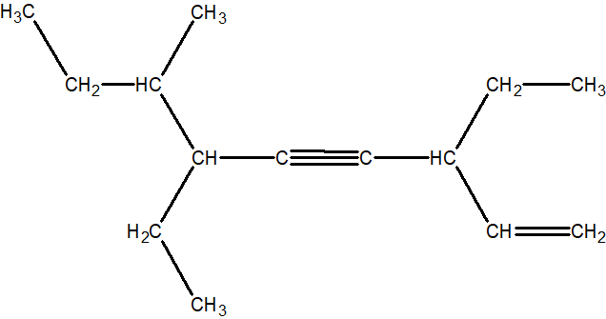
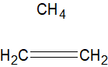
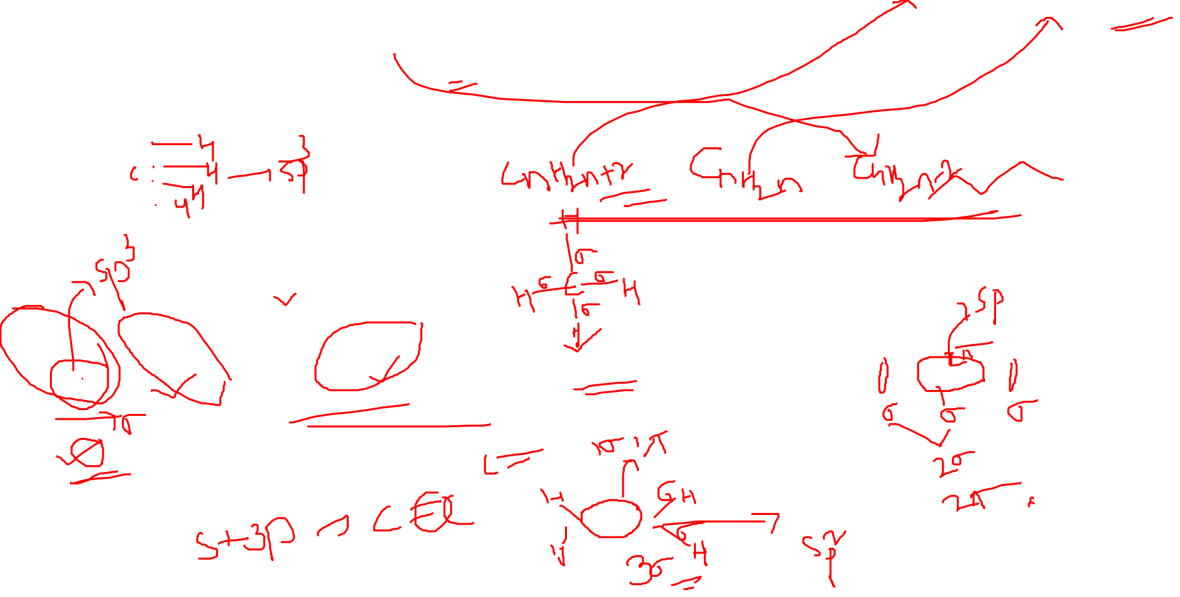
You will be able to name simple to complex alkanes, alkenes and alkynes by the end of this class

Slide 4
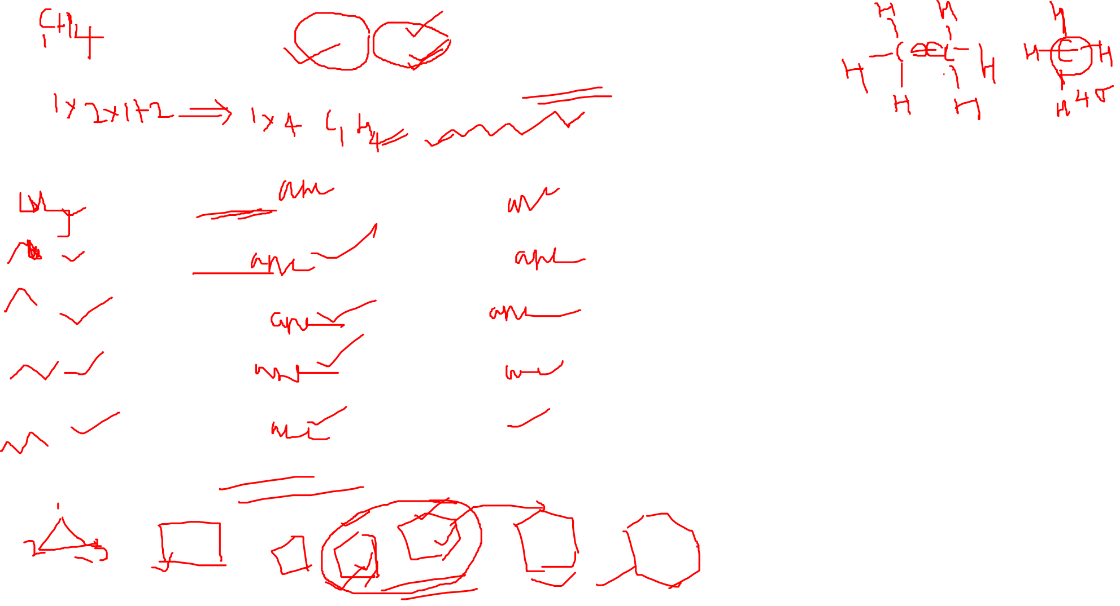
Alkane:C_{n}H_{2n+2}
C-C
C₁→ meth
C₂→ eth
C₃→ prop
C₄→ but
C₅→ pent
C₆→ hex
C₇→ hept
C₈→ oct
C₉→ non
C₁₀→ dec
CH₄ Methane
C₂H₆ Ethane
C₃H₈ Propane
C₄H₁₀ Butane
C₅H₁₂ Pentane
Notes:
Draw and insert image here..

Slide 5
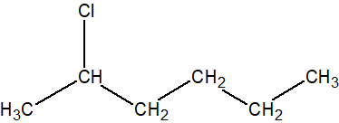
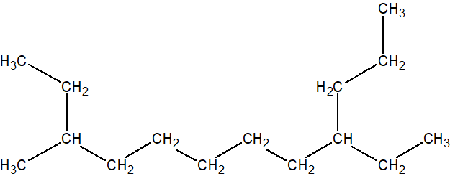
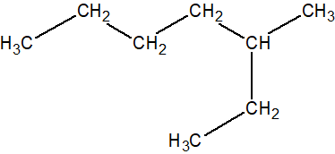
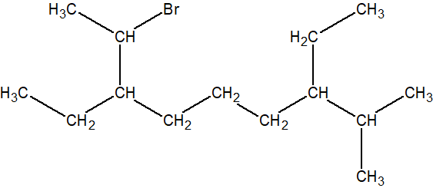
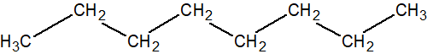
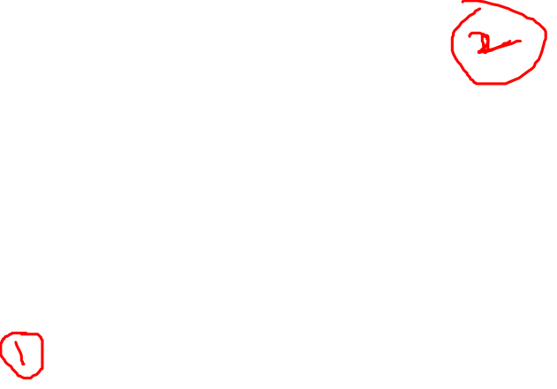
Classwork: Alkanes
Branched chains:
Choose the longest carbon chain/ the one with more substituents.
Unbranched chains:
1. Number of carbons + functional group.
3
1
2
5
4
Notes:
1.

Slide 6
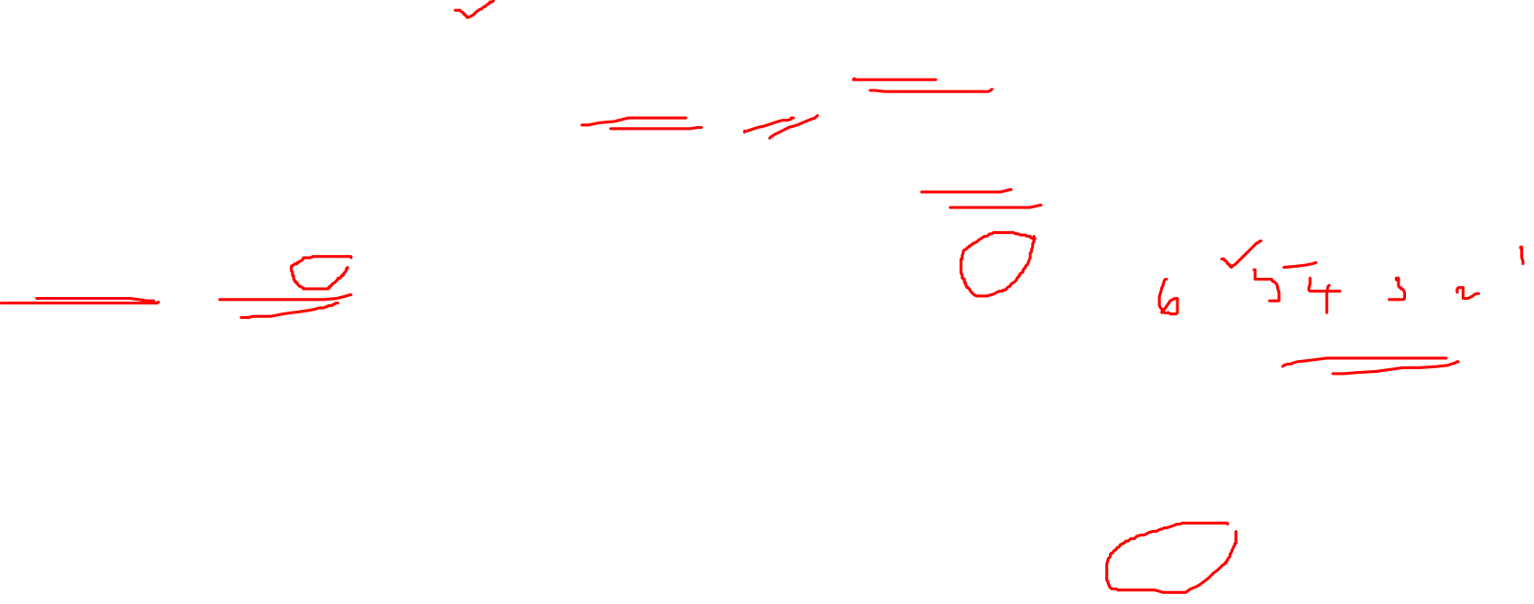
Classwork: Alkanes
Branched chains:
1. Choose the longest carbon chain
2. If substituents attached, choose the one with more substituents.
3. If only one substituent: substituent gets lower number.
3
Straight Chain: carbon chain & suffix (ane/ene/yne)
3-methylheptane
6
1
3
5
12
6
4
2
9-ethyl-3-methyldodecane
7
5
3
4
1
2-chlorohexane
2
1
10
2
11
2
3
5
7
9
1
1
2
4
6
8
3
5
7
9
5
6
8
2
8
4
4
1
3
5
7
4
6
n-octane
2-bromo-3,7-diethyl-8-methylnonane
Notes:
1.

Slide 7
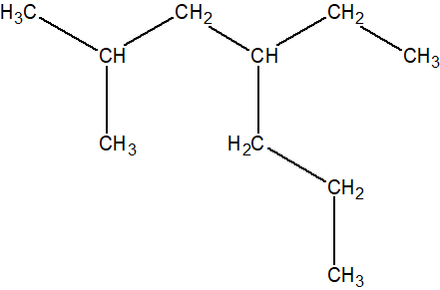
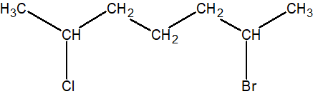
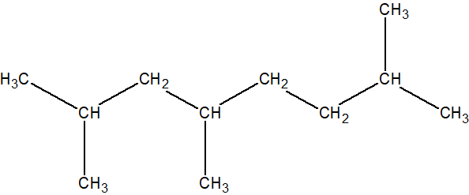
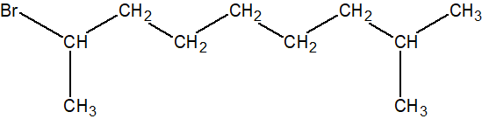
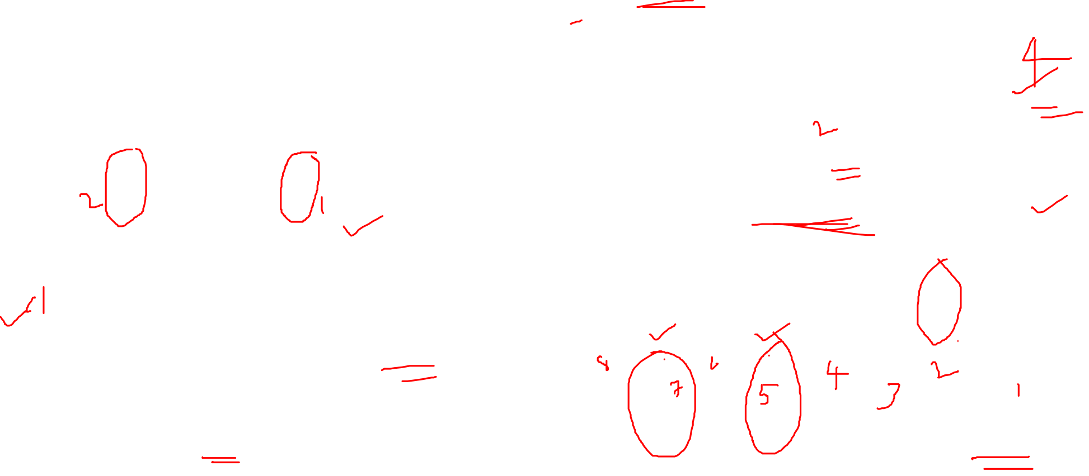
Classwork: Alkanes
Branched chains:
4. If 2/more identical substituents: use di, tri, tetra etc.
5. If 2/more different substituents: first substituent gets lower number.
6. If 2 substituents are at the same positions from their ends:
assign less number to the one that comes first in alphabetical order.
1
3
2
4
7
5
3
1
7
6
6
4
2
5
6
4-ethyl-2-methylheptane
2-bromo-6-chloroheptane
7
9
7
3
5
7
9
1
3
5
2
6
7
4
6
8
2
4
6
8
8
1
2-bromo-8-methylnonane
2,4,7-trimethyloctane

Slide 8
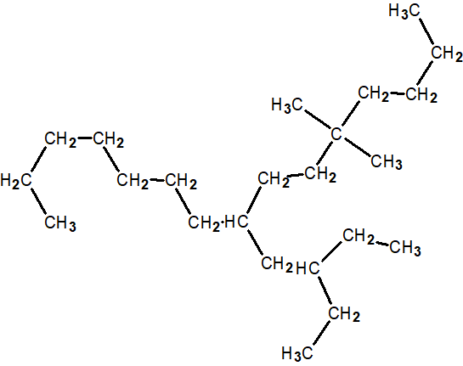
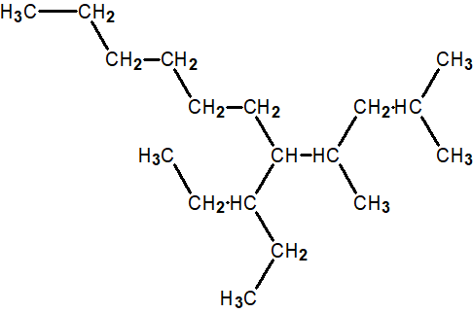

Classwork: Alkanes
Naming the ‘branched substituents’:
7. Assign ‘1’ to the substituent’s carbon attached to the parent chain, everything is same.
8. Make it right as substituent: “ane to yl”.
9. Alphabetical order: iso, neo taken into consideration but NOT sec-, ter-, etc.
1
11
10
11
2
9
8
1
4
3
7
6
3
2
13
5
10
12
5
4
14
11
10
7
6
9
8
1
15
1
2
2
3
3
4
5-(1-ethylpropyl)-2,4-dimethylundecane
8-(2-ethylbutyl)-5,5-dimethylpentadecane

Slide 9
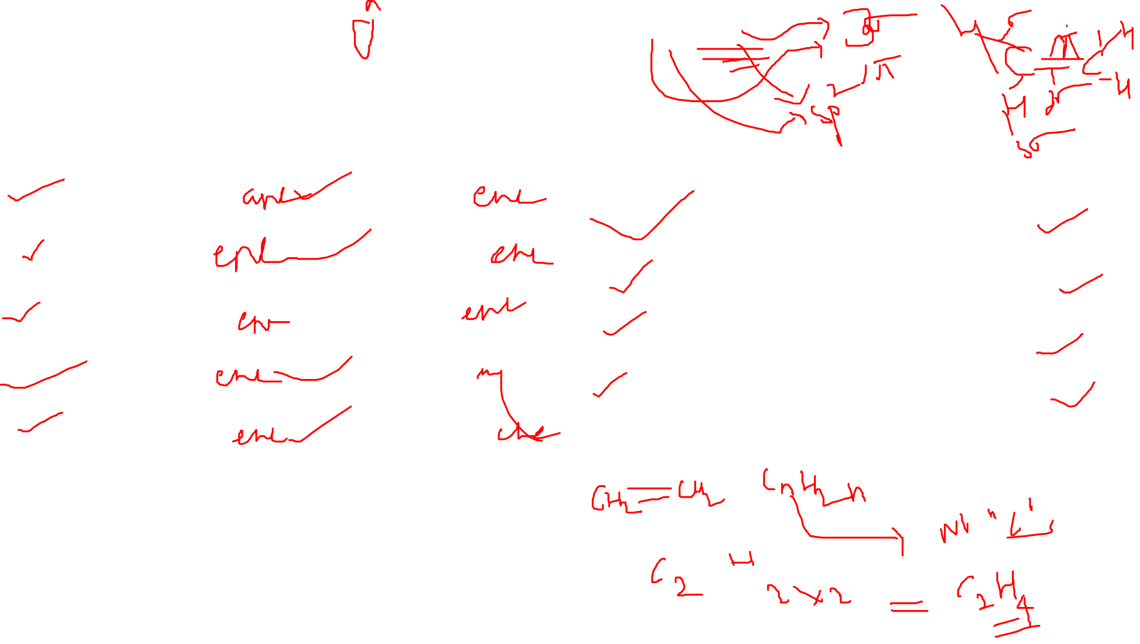
Alkene:C_{n}H_{2n}
C=C
C₁→ meth
C₂→ eth
C₃→ prop
C₄→ but
C₅→ pent
C₆→ hex
C₇→ hept
C₈→ oct
C₉→ non
C₁₀→ dec
C₂H₄ Ethene
C₃H₆ Propene
C₄H₈ Butene
C₅H₁₀ Pentene
Notes:
Draw and insert image here..

Slide 10
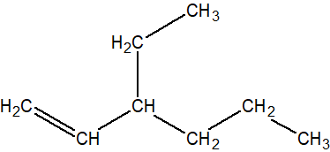
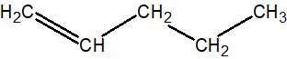
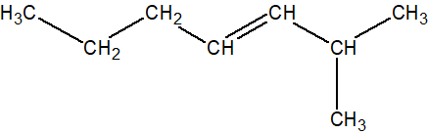
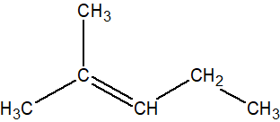
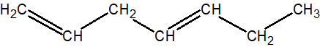

Classwork: Alkenes
Parent chain must include double bond.
Double bond gets priority over substituents and gets lower number possible.
If 2/more double bonds present, suffix= ‘adiene’ or ‘atriene’ etc.
pent-1-ene
1
3-ethylhex-1-ene
2
1
3
5
2
4
1
3
5
2
4
6
3
2-methylhept-3-ene
7
5
3
1
6
4
2
2-methylpent-2-ene
4
hepta-1,4-diene
5
2
4
1
3
5
7
1
3
5
2
4
6

Slide 11
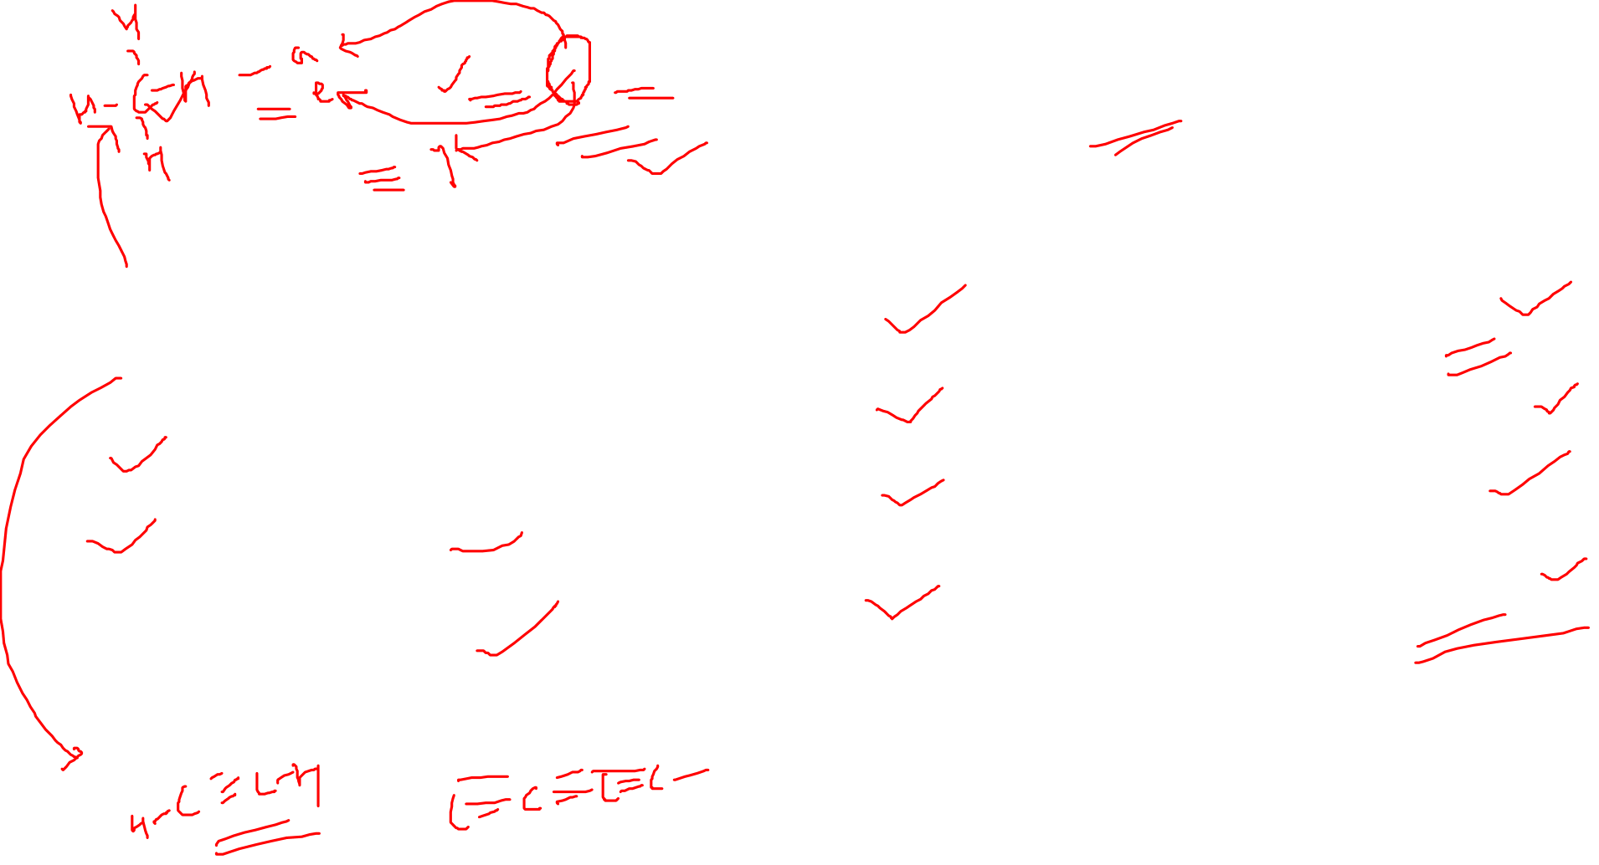
Alkyne: C_{n}H_{2n-2}
C C
C₁→ meth
C₂→ eth
C₃→ prop
C₄→ but
C₅→ pent
C₆→ hex
C₇→ hept
C₈→ oct
C₉→ non
C₁₀→ dec
C₂H₂ Ethyne
C₃H₄ Propyne
C₄H₆ Butyne
C₅H₈ Pentyne
Notes:
Draw and insert image here..

Slide 12

IUPAC Basic Rules: Review
Common Rules: (alkanes, alkenes & alkynes)
Choose the longest carbon chain
If substituents attached, choose the one with more substituents.
If only one substituent: substituent gets lower number.
If 2/more identical substituents: use di, tri, tetra etc.
If 2/more different substituents: first substituent gets lower number.
If 2 substituents are at the same positions from their ends: assign less number to the one that comes first in alphabetical order.
Alkenes:
Parent chain must include double bond.
Double bond gets priority over substituents and gets lower number.
If 2/more double bonds present, suffix= ‘adiene’ or ‘atriene’ etc.
Usually, double and triple bonds have equal priority.
Alkynes:
Parent chain must include triple bond.
If both ‘db’ and ‘tb’ at same position from either ends: double bond gets priority over triple bond and gets lower number.
If 2/more triple bonds present, suffix= ‘adiyne’ or ‘atriyne’ etc.
If both db and tb are present, name as ‘en-yne’.
Notes:
If chains of equal length are competing for selection as the parent chain, then the choice goes in series to: a) the chain which has the greatest number of side chains. b) the chain whose substituents have the lowest- numbers. c) the chain having the greatest number of carbon atoms in the smaller side chain. d)the chain having the least branched side chains.
SOURCE;
http://www.chem.uiuc.edu/GenChemReferences/nomenclature_rules.html

Slide 13
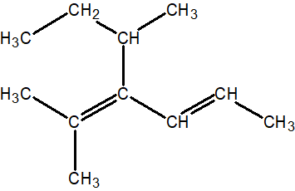
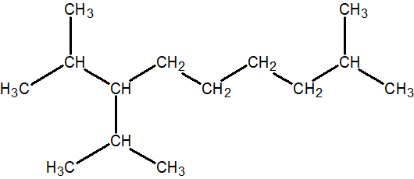
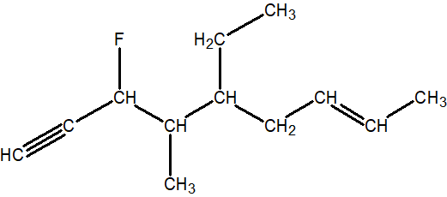
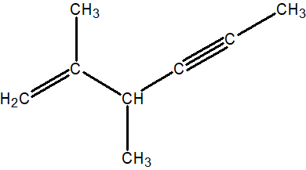
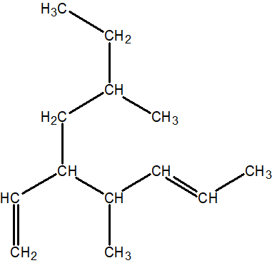
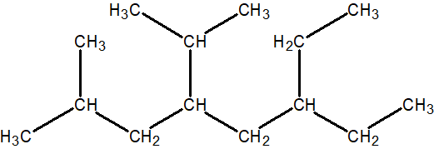

C
A
B
E
D
F
G
H
PRACTICE

